Slide 1
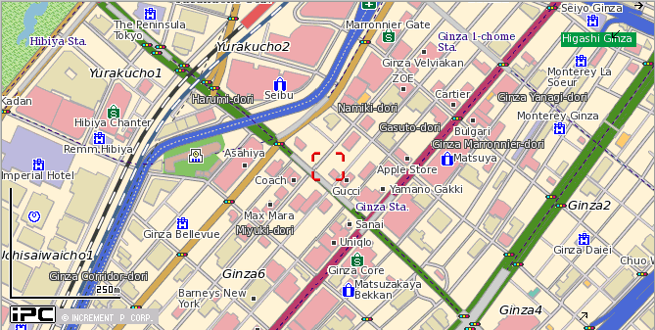
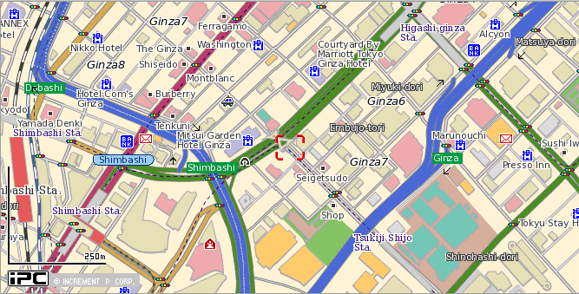
Conference Hall
[ T’S GINZA ］
Japan Coast Guard Hydrographic and Oceanographic Department

